Slide 1
Parallel and Distributed Computing
Networks Principles of Parallel Algorithm Design

Slide 2
Today We Will learn,
Principles of Parallel Algorithm Design
Parallel Algorithm Design-Basic Terminologies
Decomposition Techniques
Recursive decomposition
Data-decomposition,
Exploratory decomposition, and
Speculative decomposition

Slide 3
Principles of Parallel Algorithm Design
Algorithm development is a critical component of problem solving using computers.
A sequential algorithm is essentially a recipe or a sequence of basic steps for solving a given problem using a serial computer.
Similarly, a parallel algorithm is a recipe that tells us how to solve a given problem using multiple processors.
However, specifying a parallel algorithm involves more than just specifying the steps. At the very least, a parallel algorithm has the added dimension of concurrency and the algorithm designer must specify sets of steps that can be executed simultaneously.

Slide 4
Principles of Parallel Algorithm Design
In practice, specifying a parallel algorithm may include some or all of the following:
Identifying portions of the work that can be performed concurrently.
Mapping the concurrent pieces of work onto multiple processes running in parallel.
Distributing the input, output, and intermediate data associated with the program.
Managing accesses to data shared by multiple processors.
Synchronizing the processors at various stages of the parallel program execution.

Slide 5
Principles of Parallel Algorithm Design
Two important steps in design of parallel algorithms are
Dividing a computation into smaller computations and
Assigning them to different processors for parallel execution

Slide 6
Parallel Algorithm Design-Basic Terminologies
Decomposition
The process of dividing a computation into smaller parts, some or all of which may potentially be executed in parallel
Tasks
Programmer-defined units of computation into which the main computation is subdivided by means of decomposition.
Simultaneous execution of multiple tasks is the key to reducing the time required to solve the entire problem.
Tasks can be of arbitrary size, but once defined, they are regarded as indivisible units of computation.
The tasks into which a problem is decomposed may not all be of the same size.

Slide 7
Parallel Algorithm Design-Basic Terminologies
Task Dependency Graph
An abstraction (summary) used to express dependencies among tasks and their relative order of execution is known as a task dependency graph.
A task-dependency graph is a directed acyclic graph in which the nodes represent tasks and the directed edges indicate the dependencies amongst them.
The task corresponding to a node can be executed when all tasks connected to this node by incoming edges have completed.
Task-dependency graphs can be disconnected and the edge set of a task-dependency graph can be empty.
This is the case for matrix-vector multiplication, where each task computes a subset of the entries of the product vector.

Slide 8
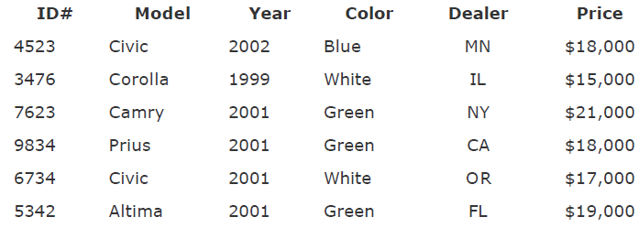
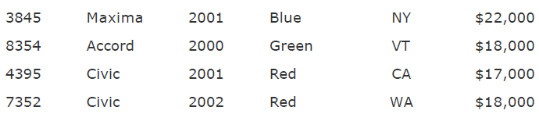
Parallel Algorithm Design-Basic Terminologies
Task Dependency Graph
Consider database storing information about used vehicles.
MODEL="Civic" AND YEAR="2001" AND (COLOR="Green" OR COLOR="White")

Slide 9
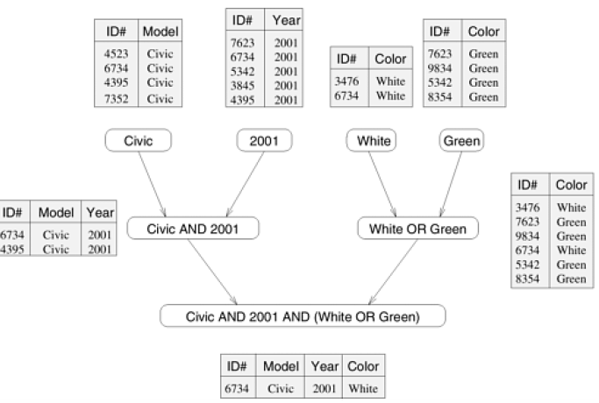
Parallel Algorithm Design-Basic Terminologies
Task Dependency Graph
Consider the computations performed in processing the following query: MODEL="Civic" AND YEAR="2001" AND (COLOR="Green" OR COLOR="White")

Slide 10
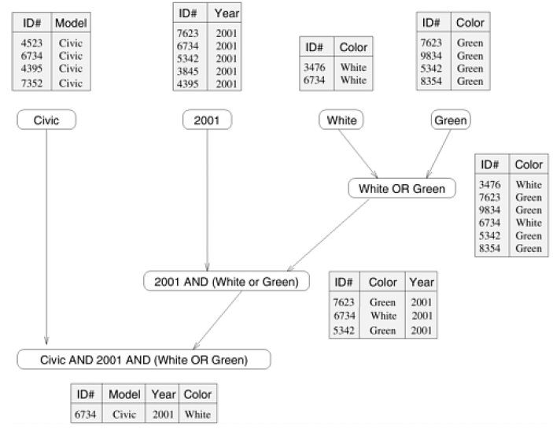
Parallel Algorithm Design-Basic Terminologies
Task Dependency Graph
Consider the computations performed in processing the following query: MODEL="Civic" AND YEAR="2001" AND
(COLOR="Green" OR COLOR="White")

Slide 11
Parallel Algorithm Design-Basic Terminologies
Granularity
The number and size of tasks into which a problem is decomposed determines the granularity of the decomposition.
A decomposition into a large number of small tasks is called fine-grained and
A decomposition into a small number of large tasks is called coarse-grained.

Slide 12
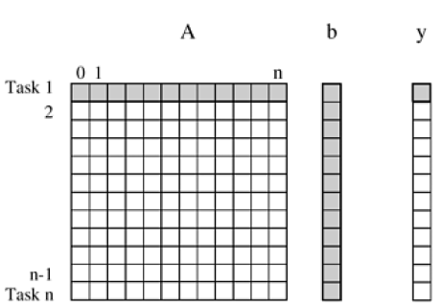
Parallel Algorithm Design-Basic Terminologies
Granularity
Consider an example “Dense matrix-vector multiplication”
Decomposition of dense matrix-vector multiplication into n tasks, where n is the number of rows in the matrix. The portions of the matrix and the input and output vectors accessed by Task 1 are highlighted. It is an example of fine-grained because each of a large number of tasks performs a single dot-product.

Slide 13
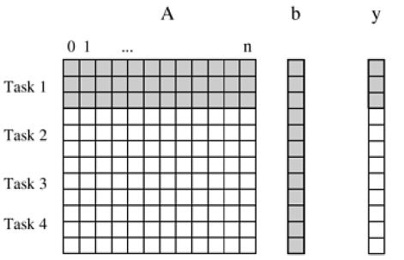
Parallel Algorithm Design-Basic Terminologies
Granularity
Decomposition of dense matrix-vector multiplication into four tasks. The portions of the matrix and the input and output vectors accessed by Task 1 are highlighted.
It is an example of coarse-grained decomposition of the same problem into four tasks, where each tasks computes n/4 of the entries of the output vector of length n.

Slide 14
Parallel Algorithm Design-Basic Terminologies
Degree of concurrency.
The maximum number of tasks that can be executed simultaneously in a parallel program at any given time is known as its maximum degree of concurrency.
In most cases, the maximum degree of concurrency is less than the total number of tasks due to dependencies among the tasks.

Slide 15
Parallel Algorithm Design-Basic Terminologies
Degree of concurrency.
For example, maximum degree of concurrency in the task-graph

Slide 16
Parallel Algorithm Design-Basic Terminologies
Average Degree of concurrency
A more useful indicator of a parallel program's performance is the average degree of concurrency, which is the average number of tasks that can run concurrently over the entire duration of execution of the program.
Both the maximum and the average degrees of concurrency usually increase as the granularity of tasks becomes smaller (finer).

Slide 17
Parallel Algorithm Design-Basic Terminologies
Average Degree of concurrency
For example, the decomposition of matrix-vector multiplication shown in Figure has a fairly small granularity and a large degree of concurrency.
The decomposition for the same problem shown in Figure has a larger granularity and a smaller degree of concurrency.

Slide 18
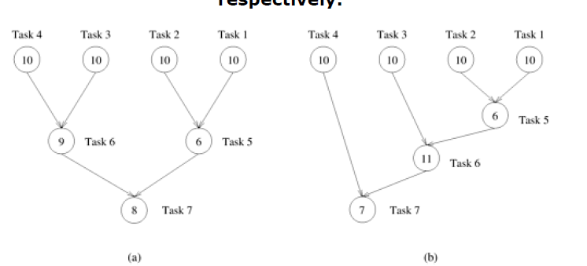
Parallel Algorithm Design-Basic Terminologies
Average Degree of concurrency
The degree of concurrency also depends on the shape of the task-dependency graph and the same granularity, in general, does not guarantee the same degree of concurrency.
For example, consider the two task graphs below. The number inside each node represents the amount of work required to complete the task corresponding to that node.

Slide 19
Parallel Algorithm Design-Basic Terminologies
Average Degree of concurrency
Average Degree of Concurrency = Total Amount of Work / Critical Path Length
The average degree of concurrency of the task graph in Figure (a) is 2.33 and that of the task graph in Figure (b) is 1.88, although both task-dependency graphs are based on the same decomposition.

Slide 20
Parallel Algorithm Design-Basic Terminologies
Critical Path & Critical Path Length
A feature of a task-dependency graph that determines the average degree of concurrency for a given granularity is its critical path.
In a task-dependency graph, let us refer to the nodes with no incoming edges by start nodes and the nodes with no outgoing edges by finish nodes.

Slide 21
Parallel Algorithm Design-Basic Terminologies
Critical Path & Critical Path Length
The sum of the weights of nodes along this path is known as the critical path length, where the weight of a node is the size or the amount of work associated with the corresponding task. The ratio of the total amount of work to the critical-path length is the average degree of concurrency. Therefore, a shorter critical path favors a higher degree of concurrency.

Slide 22
Parallel Algorithm Design-Basic Terminologies
Critical Path & Critical Path Length
For example, the critical path length is 27 in the task-dependency graph shown in Figure (a) and is 34 in the task-dependency graph shown in Figure (B)

Slide 23
Parallel Algorithm Design-Basic Terminologies
Critical Path & Critical Path Length
Since the total amount of work required to solve the problems using the two decompositions is 63 and 64, respectively, the average degree of concurrency of the two task-dependency graphs is 2.33 (63/27) and 1.88 (64/34), respectively

Slide 24
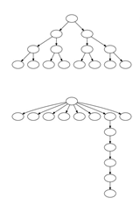
Exercise
Graph#01
A) Maximum degree of concurrency.
b) Average degree of concurrency
c) Critical path length.
d) Maximum achievable speedup over one process assuming that an arbitrarily large number of processes is available.
Graph#02

Slide 25
Graph#01
a) 8
b) Average degree of concurrency = total work done / critical path length i.e, 15/4 = 3.75
c) 4
d) 8
Graph#02
a) 8
b) Average degree of concurrency = total work done / critical path length i.e, 14/7 = 2
c) 7
d) 8

Slide 26
Parallel Algorithm Design-Basic Terminologies
Task Interaction Graph
The pattern of interaction among tasks is captured by what is known as a task-interaction graph.
The nodes in a task-interaction graph represent tasks and the edges connect tasks that interact with each other. The nodes and edges of a task-interaction graph can be assigned weights proportional to the amount of computation a task performs and the amount of interaction that occurs along an edge, if this information is known. The edges in a task interaction graph are usually undirected, but directed edges can be used to indicate the direction of flow of data, if it is unidirectional. The edge-set of a task-interaction graph is usually a superset of the edge-set of the task-dependency graph. In the database query example discussed earlier, the task-interaction graph is the same as the task-dependency graph.

Slide 27
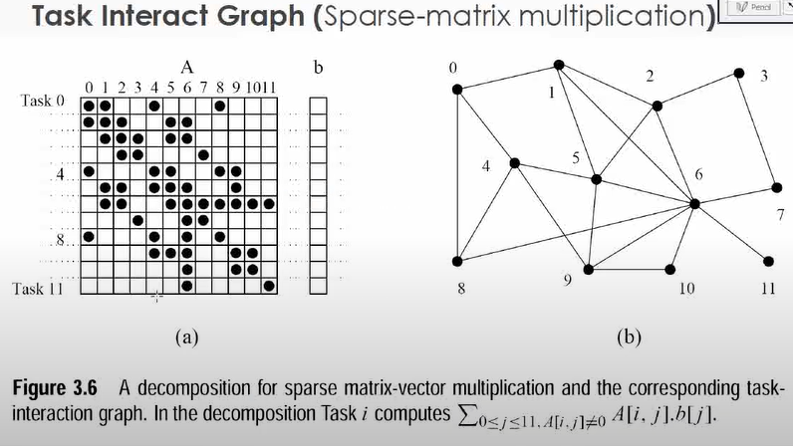
Parallel Algorithm Design-Basic Terminologies
Task Interaction Graph (Example)

Slide 28
Parallel Algorithm Design-Basic Terminologies
Processes and Mapping
process refer to a processing or computing agent that performs tasks.
it is an abstract entity that uses the code and data corresponding to a task to produce the output of that task within a finite amount of time after the task is activated by the parallel program.
In addition to performing computations, a process may synchronize or communicate with other processes, if needed.
In order to obtain any speedup over a sequential implementation, a parallel program must have several processes active simultaneously, working on different tasks.

Slide 29
Parallel Algorithm Design-Basic Terminologies
Processes and Mapping
The mechanism by which tasks are assigned to processes for execution is called mapping.
The task-dependency and task-interaction graphs that result from a choice of decomposition play an important role in the selection of a good mapping for a parallel algorithm.
A good mapping should seek to maximize the use of concurrency by mapping independent tasks onto different processes, it should seek to minimize the total completion time by ensuring that processes are available to execute the tasks on the critical path as soon as such tasks become executable, and it should seek to minimize interaction among processes by mapping tasks with a high degree of mutual interaction onto the same process.

Slide 30
Parallel Algorithm Design-Basic Terminologies
Processes and Mapping

Slide 31
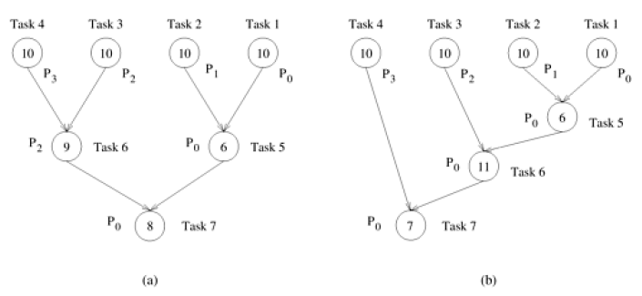
Parallel Algorithm Design-Basic Terminologies
Processes and Mapping

Slide 32
Parallel Algorithm Design-Basic Terminologies
Processes Vs Processor
Processes are logical computing agents that perform tasks.
Processors are the hardware units that physically perform computations
Treating processes and processors separately is also useful when designing parallel programs for hardware that supports multiple programming paradigms.

Slide 33
Parallel Algorithm Design-Decomposition Techniques
To solve a problem in parallel is to split the computations to be performed into a set of tasks for concurrent execution defined by the task-dependency graph.
These techniques are broadly classified as
Recursive decomposition
Data-decomposition,
Exploratory decomposition, and
Speculative decomposition.

Slide 34
Parallel Algorithm Design-Decomposition Techniques
The recursive- and data decomposition techniques are relatively general purpose as they can be used to decompose a wide variety of problems.
On the other hand, speculative- and exploratory-decomposition techniques are more of a special purpose nature because they apply to specific classes of problems.

Slide 35
Parallel Algorithm Design-Decomposition Techniques
Recursive-decomposition
Recursive decomposition is a method for inducing concurrency in problems that can be solved using the divide-and-conquer strategy.
In this technique, problem is solved by first dividing it into a set of independent subproblems.
Each one of these subproblems is solved by recursively applying a similar division into smaller subproblems followed by a combination of their results.
The divide-and-conquer strategy results in natural concurrency, as different subproblems can be solved concurrently.

Slide 36
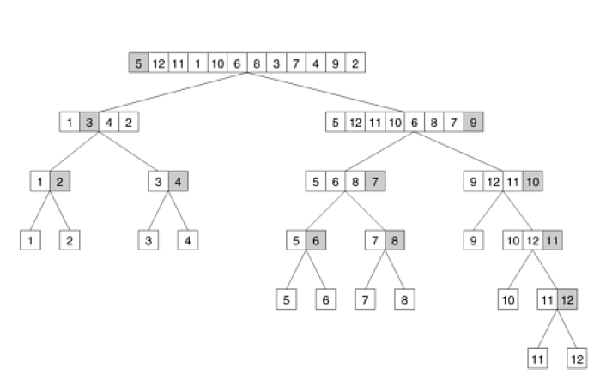
Parallel Algorithm Design-Decomposition Techniques
Recursive-decomposition (pivot Element)
.

Slide 37
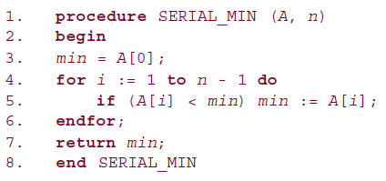
Parallel Algorithm Design-Decomposition Techniques
Recursive-decomposition.
A serial program for finding the minimum in an array of numbers A of length n.
It is easy to see that this serial algorithm exhibits no concurrency.

Slide 38
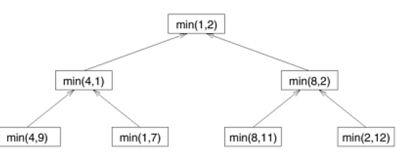
Parallel Algorithm Design-Decomposition Techniques
Recursive-decomposition.
The task-dependency graph for finding the minimum number in the sequence {4, 9, 1, 7, 8, 11, 2, 12}. Each node in the tree represents the task of finding the minimum of a pair of numbers.
It is easy to see that this serial algorithm exhibits no concurrency.

Slide 39
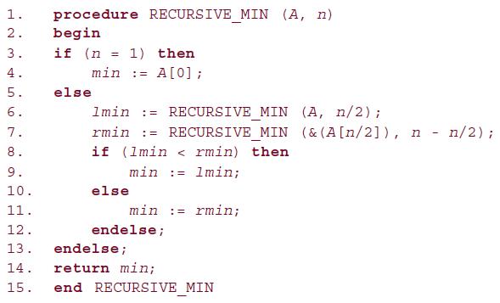
Parallel Algorithm Design-Decomposition Techniques
Recursive-decomposition.
A recursive program for finding the minimum in an array of numbers A of length n.

Slide 40
Parallel Algorithm Design-Decomposition Techniques
Data-decomposition.
Data decomposition is a powerful and commonly used method for deriving concurrency in algorithms that operate on large data structures.
In this method, the decomposition of computations is done in two steps.
In the first step, the data on which the computations are performed is partitioned, and in the second step, this data partitioning is used to induce a partitioning of the computations into tasks.

Slide 41
Parallel Algorithm Design-Decomposition Techniques
Data-decomposition.
The partitioning of data can be performed in many possible ways
Partitioning Output Data
Partitioning Input Data
Partitioning both Input and Output Data
Partitioning Intermediate Data
The Owner-Computes Rule

Slide 42
Parallel Algorithm Design-Decomposition Techniques
Data-decomposition - Partitioning Output Data
In many computations, each element of the output can be computed independently of others as a function of the input.
In such computations, a partitioning of the output data automatically induces a decomposition of the problems into tasks, where each task is assigned the work of computing a portion of the output.

Slide 43
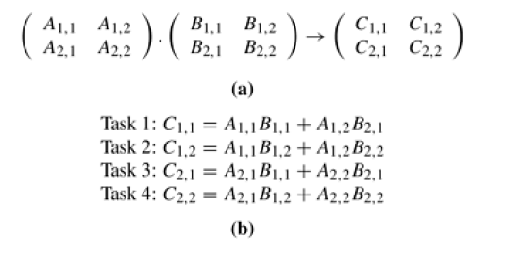
Parallel Algorithm Design-Decomposition Techniques
Data-decomposition - Partitioning Output Data
In Figure (a) Partitioning of input and output matrices into 2 x 2 submatrices.
In Figure (b) A decomposition of matrix multiplication into four tasks based on the partitioning of the matrices in (a).

Slide 44
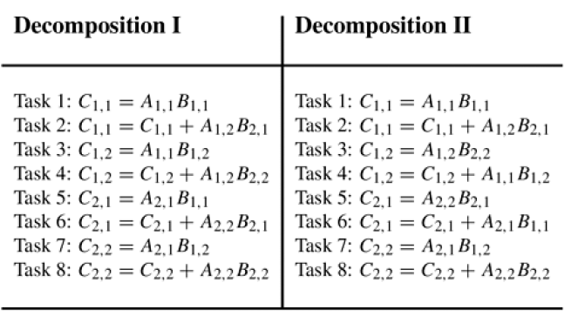
Parallel Algorithm Design-Decomposition Techniques
Data-decomposition - Partitioning Output Data
In Two examples of decomposition of matrix multiplication into eight tasks

Slide 45
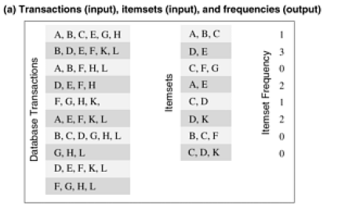
Parallel Algorithm Design-Decomposition Techniques
Data-decomposition - Partitioning Output Data
Example # 2 : Computing frequencies of item sets in a transaction database
The database shown in Figure (1) consists of 10 transactions, and we are interested in computing the frequency of the eight itemsets shown in the second column in Figure.
The actual frequencies of these itemsets in the database, which are the output of the frequency-computing program, are shown in the third column.
For instance, itemset {D, K} appears twice, once in the second and once in the ninth transaction

Slide 46
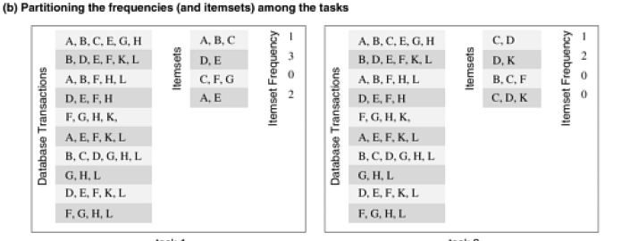
Parallel Algorithm Design-Decomposition Techniques
Data-decomposition - Partitioning Output Data
shows how the computation of frequencies of the itemsets can be decomposed into two tasks by partitioning the output into two parts and having each tas compute its half of the frequencies.

Slide 47
Parallel Algorithm Design-Decomposition Techniques
Data-decomposition - Partitioning Input Data
Partitioning of output data can be performed only if each output can be naturally computed as a function of the input.
In many algorithms, it is not possible or desirable to partition the output data.
For example, while finding the minimum, maximum, or the sum of a set of numbers, the output is a single unknown value. In a sorting algorithm, the individual elements of the output cannot be efficiently determined in isolation.
In such cases, it is sometimes possible to partition the input data, and then use this partitioning to induce concurrency.

Slide 48
Parallel Algorithm Design-Decomposition Techniques
Data-decomposition - Partitioning Input Data
In such cases, it is sometimes possible to partition the input data, and then use this partitioning to induce concurrency.
A task is created for each partition of the input data and this task performs as much computation as possible using these local data.
Note that the solutions to tasks induced by input partitions may not directly solve the original problem. In such cases, a follow-up computation is needed to combine the results. For example, while finding the sum of a sequence of N numbers using p processes (N > p), we can partition the input into p subsets of nearly equal sizes. Each task then computes the sum of the numbers in one of the subsets. Finally, the p partial results can be added up to yield the final result.

Slide 49
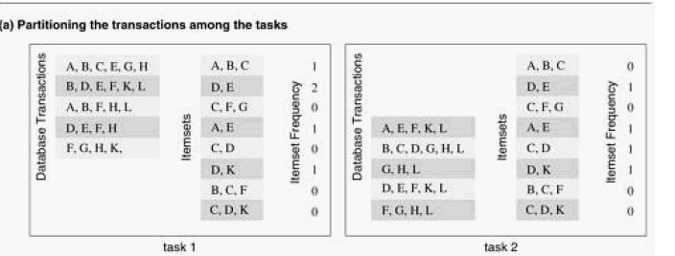
Parallel Algorithm Design-Decomposition Techniques
Data-decomposition - Partitioning Input Data (Example)
The problem of computing the frequency of a set of itemsets in a transaction database described earlier, can also be decomposed based on a partitioning of input data.
Figure (a) shows a decomposition based on a partitioning of the input set of transactions.

Slide 50
Parallel Algorithm Design-Decomposition Techniques
Data-decomposition - Partitioning Input and output Data
Partition the output data, partitioning of input data can offer additional concurrency.
For example, consider the 4-way decomposition shown in Figure (b) for computing itemset frequencies. Here, both the transaction set and the frequencies are divided into two parts and a different one of the four possible combinations is assigned to each of the four tasks. Each task then computes a local set of frequencies.
Finally, the outputs of Tasks 1 and 3 are added together, as are the outputs of Tasks 2 and 4.

Slide 51
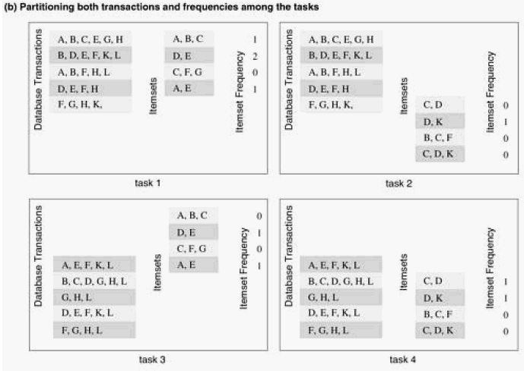
Parallel Algorithm Design-Decomposition Techniques
Data-decomposition - Partitioning Input and output Data (Example)

Slide 52
Parallel Algorithm Design-Decomposition Techniques
Data-decomposition - Partitioning Intermediate Data
Algorithms are often structured as multi-stage computations such that the output of one stage is the input to the subsequent stage.
A decomposition of such an algorithm can be derived by partitioning the input or the output data of an intermediate stage of the algorithm.
Partitioning intermediate data can sometimes lead to higher concurrency than partitioning input or output data.
Often, the intermediate data are not generated explicitly in the serial algorithm for solving the problem and some restructuring of the original algorithm may be required to use intermediate data partitioning to induce a decomposition.

Slide 53
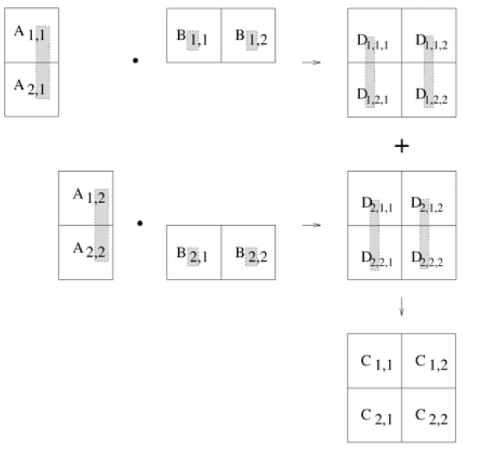
Parallel Algorithm Design-Decomposition Techniques
Data-decomposition - Partitioning Intermediate Data (Example)
Multiplication of matrices A and B with partitioning of the three-dimensional intermediate matrix D.

Slide 54
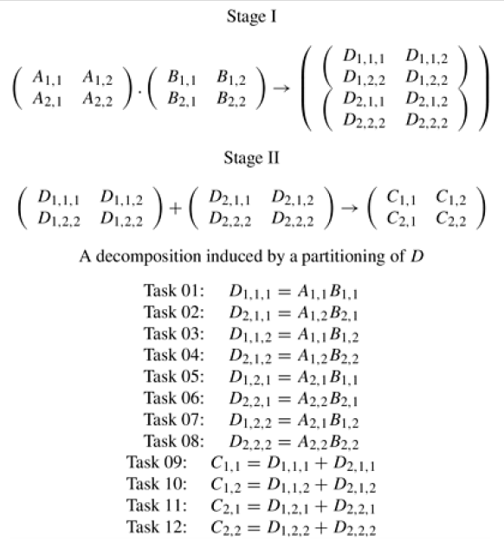
Parallel Algorithm Design-Decomposition Techniques
Data-decomposition - Partitioning Intermediate Data (Example)
A decomposition of matrix multiplication based on spartitioning the intermediate three-dimensional matrix.

Slide 55
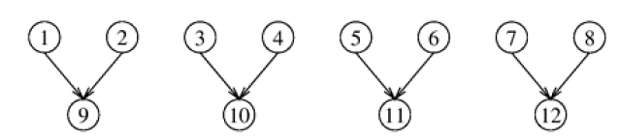
Parallel Algorithm Design-Decomposition Techniques
Data-decomposition - Partitioning Intermediate Data (Example)
The task-dependency graph of the decomposition shown

Slide 56
Parallel Algorithm Design-Decomposition Techniques
Data-decomposition - The Owner-Computes Rule –
A decomposition based on partitioning output or input data is also widely referred to as the owner-computes rule.
The idea behind this rule is that each partition performs all the computations involving data that it owns. Depending on the nature of the data or the type of data-partitioning, the owner-computes rule may mean different things.
For instance, when we assign partitions of the input data to tasks, then the owner-computes rule means that a task performs all the computations that can be done using these data.
On the other hand, if we partition the output data, then the owner-computes rule means that a task computes all the data in the partition assigned to it

Slide 57
Parallel Algorithm Design-Decomposition Techniques
Exploratory Decomposition
used to decompose problems whose underlying computations correspond to a search of a space for solutions.
In exploratory decomposition, we partition the search space into smaller parts, and search each one of these parts concurrently, until the desired solutions are found.
For an example of exploratory decomposition, consider the 15-puzzle problem.

Slide 58
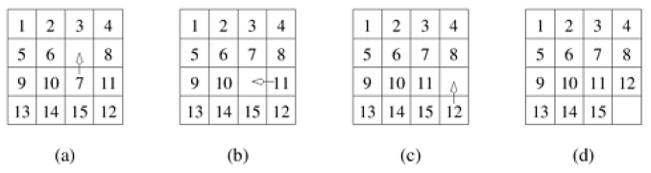
Parallel Algorithm Design-Decomposition Techniques
Exploratory Decomposition
A 15-puzzle problem instance showing the initial configuration (a), the final configuration (d), and a sequence of moves leading from the initial to the final configuration.

Slide 59
Parallel Algorithm Design-Decomposition Techniques
Exploratory Decomposition
The 15-puzzle is typically solved using tree-search techniques.
One method for solving this problem in parallel is as follows.
First, a few levels of configurations starting from the initial configuration are generated serially until the search tree has a sufficient number of leaf nodes (i.e., configurations of the 15-puzzle).
Now each node is assigned to a task to explore further until at least one of them finds a solution.
As soon as one of the concurrent tasks finds a solution it can inform the others to terminate their searches.

Slide 60
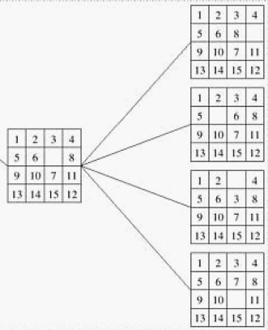


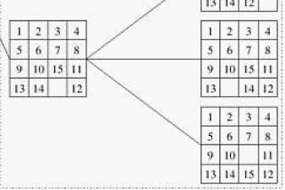
Parallel Algorithm Design-Decomposition Techniques
Exploratory Decomposition
The states generated by an instance of
the 15-puzzle problem.
Task-2
Task-1

Slide 61
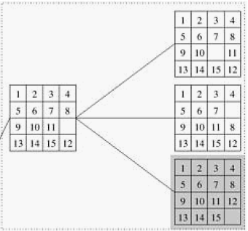
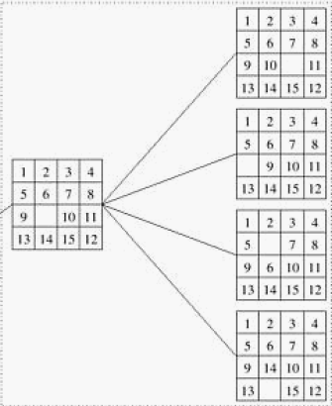
Parallel Algorithm Design-Decomposition Techniques
Exploratory Decomposition
The states generated by an instance of
the 15-puzzle problem.
Task-4
Task-3

Slide 62
Parallel Algorithm Design-Decomposition Techniques
Speculative Decomposition
Used when a program may take one of many possible computationally significant branches depending on the output of other computations that precede it.
In this situation, while one task is performing the computation whose output is used in deciding the next computation, other tasks can concurrently start the computations of the next stage.

Slide 63
Parallel Algorithm Design-Decomposition Techniques
Speculative Decomposition
This scenario is similar to evaluating one or more of the branches of a switch statement in C in parallel before the input for the switch is available.
While one task is performing the computation that will eventually resolve the switch, other tasks could pick up the multiple branches of the switch in parallel.
When the input for the switch has finally been computed, the computation corresponding to the correct branch would be used while that corresponding to the other branches would be discarded.
The parallel run time is smaller than the serial run time by the amount of time required to evaluate the condition on which the next task depends because this time is utilized to perform a useful computation for the next stage in parallel.

Slide 64
Parallel Algorithm Design-Decomposition Techniques
Speculative Decomposition
However, this parallel formulation of a switch guarantees at least some wasteful
computation.
In order to minimize the wasted computation, a slightly different formulation of speculative decomposition could be used, especially in situations where one of the outcomes of the switch is more likely than the others.
In this case, only the most promising branch is taken up a task in parallel with the preceding computation. In case the outcome of the switch is different from what was anticipated, the computation is rolled back and the correct branch of the switch is taken.

Slide 65
Parallel Algorithm Design-Decomposition Techniques
Hybrid Decomposition
Use multiple decomposition techniques together
For Example, While finding the minimum of a large set of n numbers, a purely recursive decomposition may result in far more tasks than the number of processes, P, available.
An efficient decomposition would partition the input into P roughly equal parts and have each task compute the minimum of the sequence assigned to it.
The final result can be obtained by finding the minimum of the P intermediate results by using the recursive decomposition shown

Slide 66
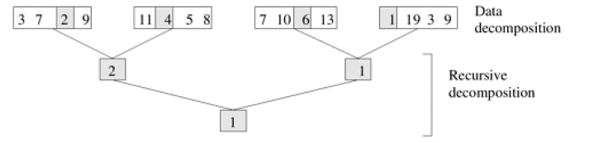
Parallel Algorithm Design-Decomposition Techniques
Hybrid Decomposition
Hybrid decomposition for finding the minimum of an array of size 16 using four tasks (3, 7, 2,9,11,4,5,8,7,10,6,13,1,19,3,9)

Slide 67
Summary

Slide 68
What is Concurrency
Maximum degree of concurrency.
Average degree of concurrency
Critical path length.
Maximum achievable speedup

Slide 69
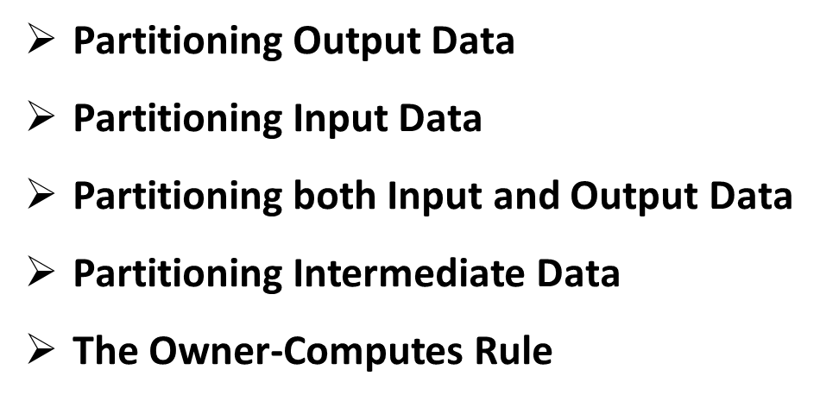
Decomposition Technique
Recursive decomposition
Data-decomposition,
Exploratory decomposition, and
Speculative decomposition.

Slide 70
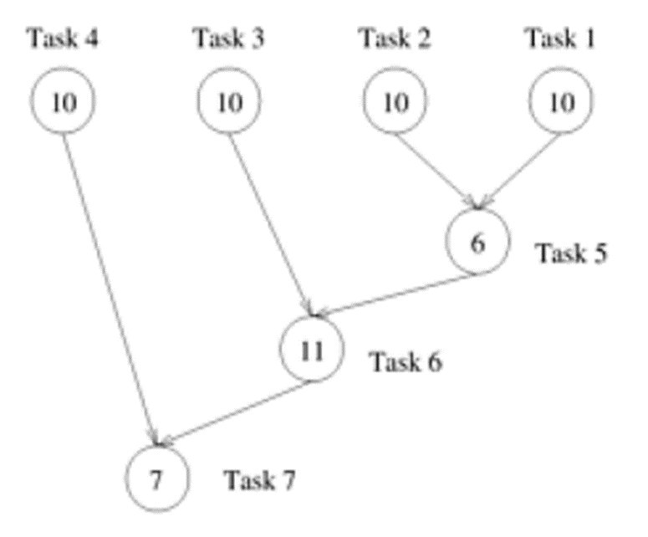
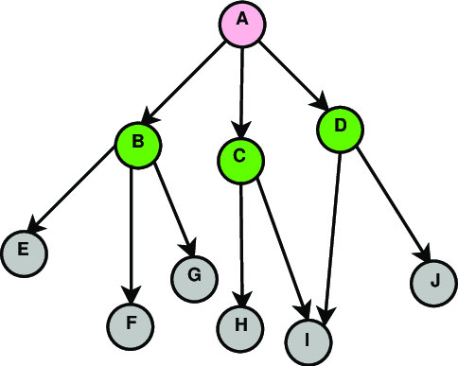
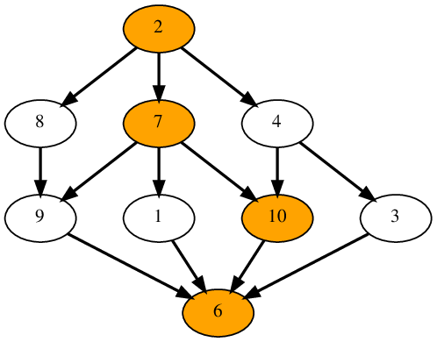
Excercises
a) Maximum degree of concurrency.
b) Average degree of concurrency
c) Critical path length.
Maximum achievable speedup
over one process assuming that an
arbitrarily large number of
processes is available.

Slide 71
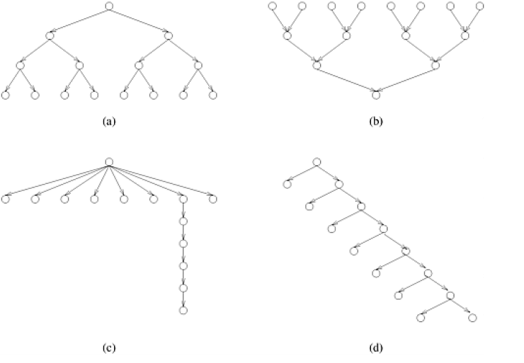
Quiz-03 03/04/2024
Q# 1 For the task graphs given in Figure (a), (b), (c) and (d) determine the following:
A) Maximum degree of concurrency.
b) Average degree of concurrency
c) Critical path length.
Maximum achievable speedup
over one process assuming that an
arbitrarily large number of
processes is available.

Slide 72
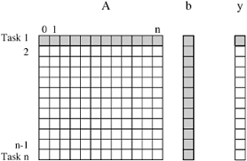
Question: dependency graph for dense-matrix vector product Answer the following questions.
What is the maximum number of tasks possible?
2. What does a task dependency graph look like for this case?
3. What is the shortest parallel execution time for the graph?
4. How many processors are needed to achieve the minimum time?
5. What is the maximum degree of concurrency? What is the average parallelism?

Slide 73
Answers
1. What is the maximum number of tasks possible?
Answer: n
2. What does a task dependency graph look like for this case?
Answer: Linear structure each task depending on the previous one.
3. What is the shortest parallel execution time for the graph?
Answer: Time to execute the longest task (row)
4. How many processors are needed to achieve the minimum time? Answer: n
5. What is the maximum degree of concurrency? What is the average parallelism?
Answer: maximum degree of concurrency: 01
Average Parallelism: 01

Slide 74

Assignment - 03 03/04/2024
Question: dependency graph for dense-matrix vector product
Answer the following questions.
1. What is the maximum number of tasks possible?
2. What does a task dependency graph look like for this case?
3. What is the shortest parallel execution time for the graph?
4. How many processors are needed to achieve the minimum time?
5. What is the maximum degree of concurrency? What is the average parallelism?

